Slide 1



EDUp FORDCS V1.0 System Requirements
Vienna, April.2022
F
Compendium
FORDSC Project
Edu Platform
v2022.04
MSc. Ömer Karacan
karacankos@gmail.com

Slide 2
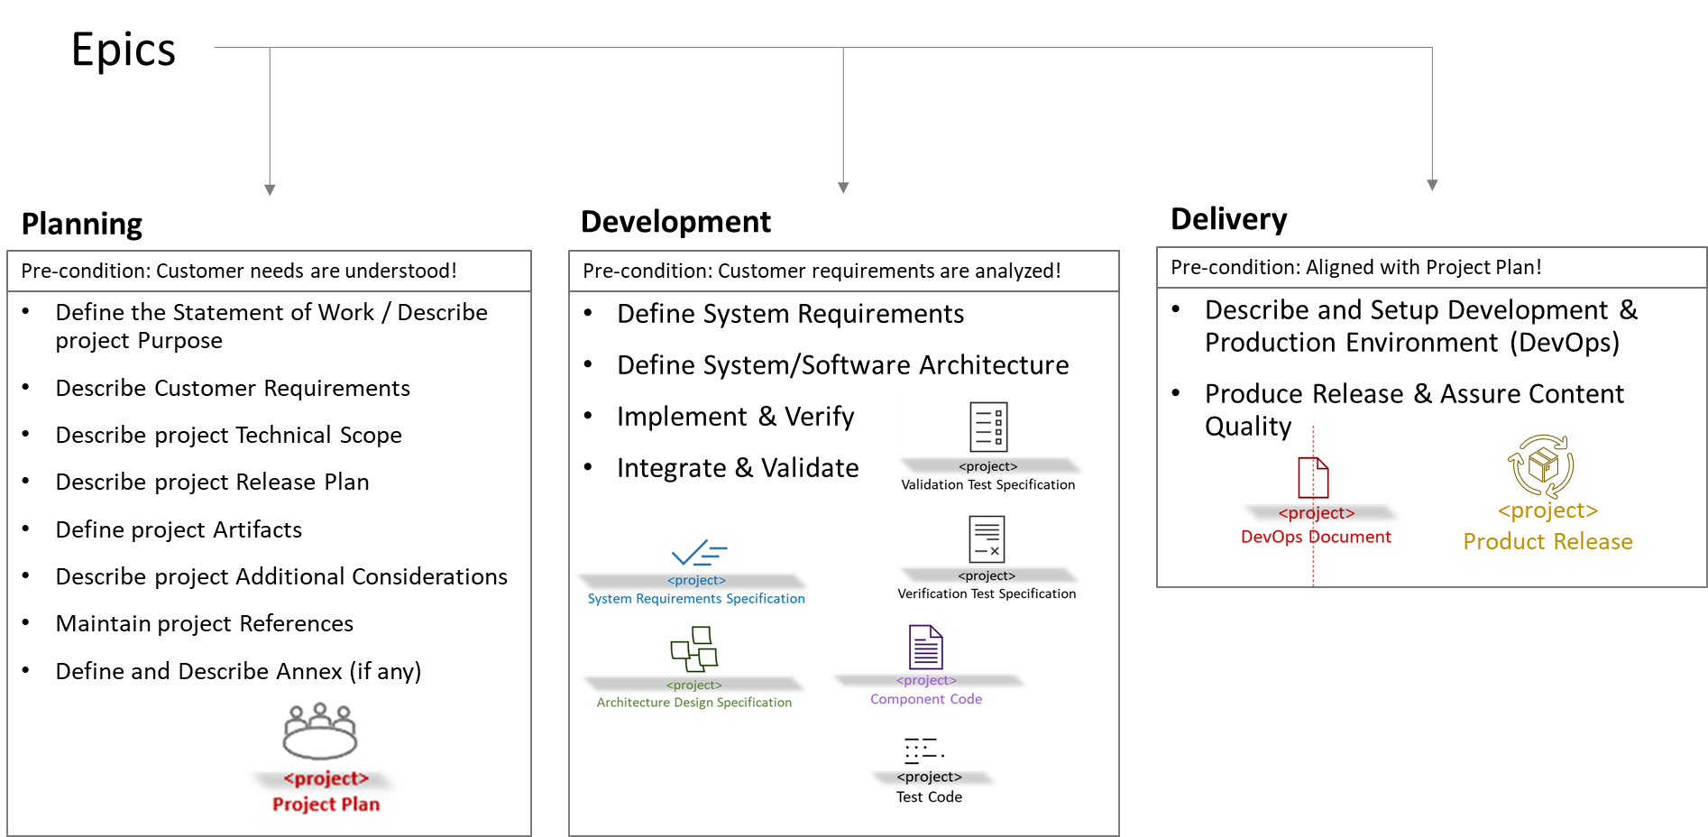
EDUp-Full-Stack-Software-Project-Development-Method Development

Slide 3
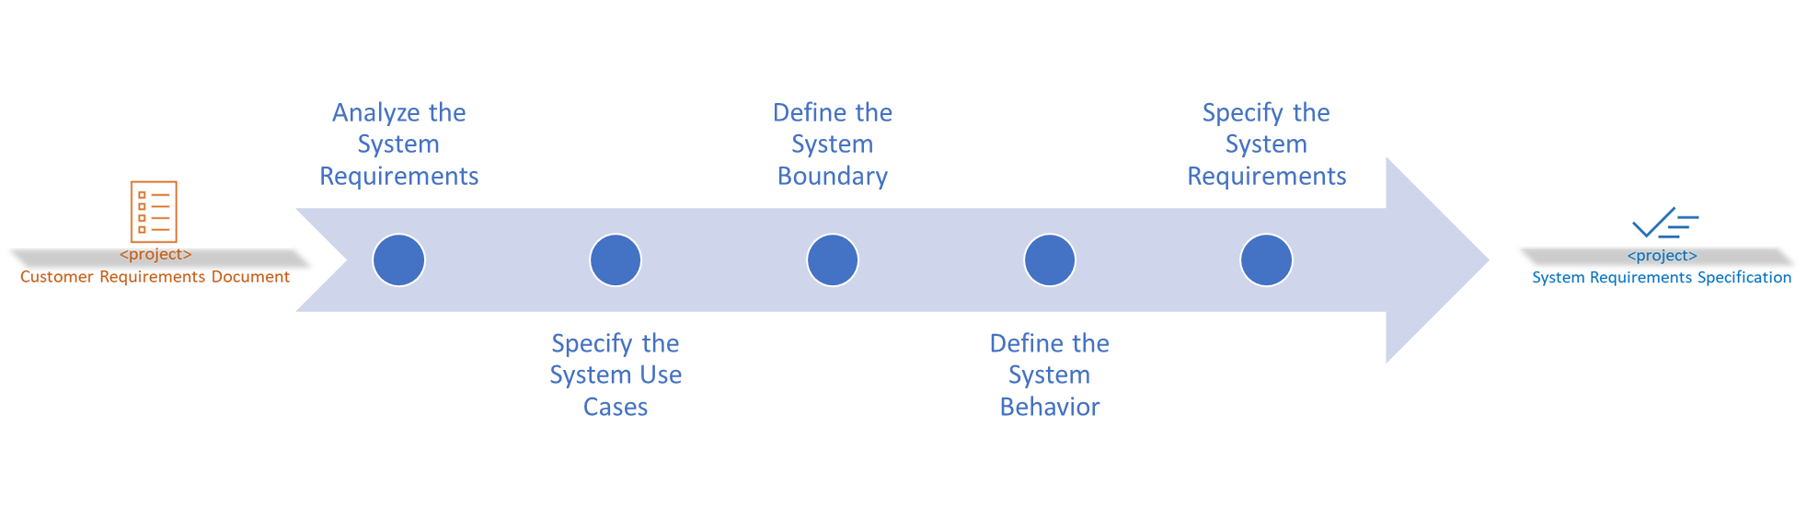
Define System Requirements
Requirements Analysis Work-stream Tasks

Slide 4
Define System Requirements

Slide 5
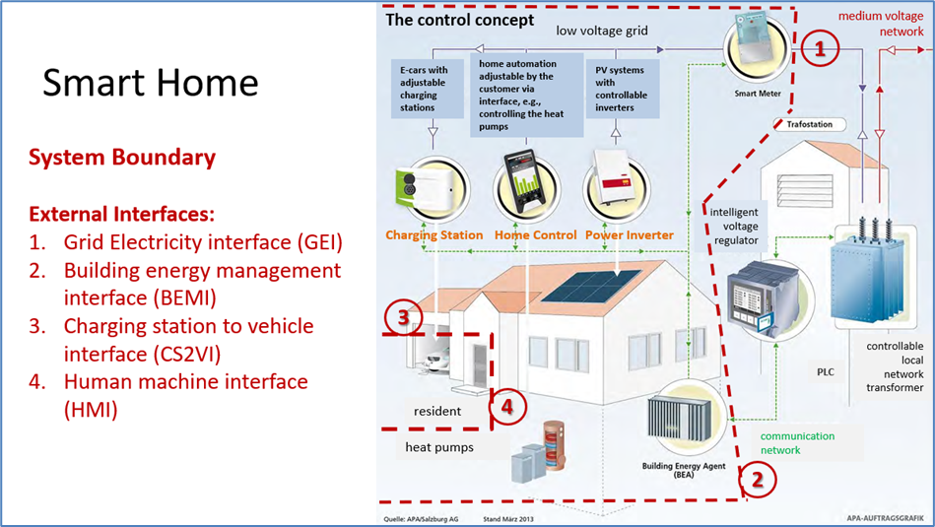
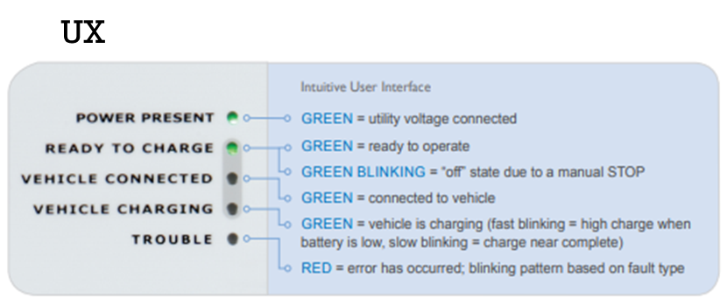
System Boundary - Illustrated
→ Method Task: Analyze the system requirements!
→ Method Task: Define the system boundary!
Ref.: SmartHome_ConceptSpecificationSimplified_v2022.1.docx
Ref.: FORDCS-V1.0 Customer requirements

Slide 6
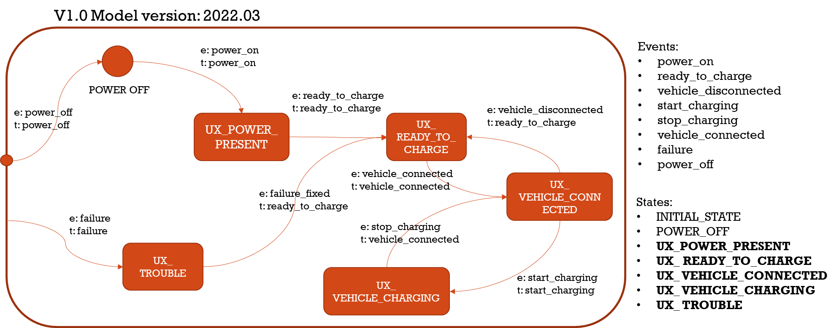
FORDCS-V1.0 System States
→ Method Task: Analyze the system requirements!
→ Method Task: Define the system behavior!
Launch the CS V1.0
Charge the Car [REF_SHC]
CS Failure Handling V1.0
Ref.: FORDCS-V1.0 Customer requirements

Slide 7

System Use Cases Use Case Report Factory Setting V1.0
→ Method Task: Specify the system use cases!
Following scenario is assumed:
ASSUMPTION: Any Actors may retrieve the Data from the FORDCS!
Use Case should be implemented referring to the Swagger interface design: https://app.swaggerhub.com/apis/karacankos/fordcs/1.0-oas3
GET https://api.example.com/v1/reportCsFactorySetting

Slide 8

System Use Cases Use Case Run-time Status Report V1.0
→ Method Task: Specify the system use cases!
Following scenario is assumed:
ASSUMPTION: ONLY the following Actors may receive the Data from the FORDCS:
“Home resident”, “Charging Station System Operator”, “Building Technology System Operator”, and “BEA”!
Use Case should be implemented referring to the Swagger interface design: https://app.swaggerhub.com/apis/karacankos/fordcs/1.0-oas3
GET https://api.example.com/v1/runtimeStatusReport/{user}

Slide 9

System Use Cases during Charging
→ Method Task: Specify the system use cases!
<Customer Use Case>
System Use Case
Launch the CS V1.0
System Use Case
Charge the Car [REF_SHC] V1.0
Following scenario is assumed:
ASSUMPTION: Only the user “service” may get/set the FMS state for FORDCS operations!
The System Use Cases are realized by the Charging Control Interfaces:
GET https://api.example.com/v1/monitorVehicleChargingState/{user} , where user=“service”
PUT https://api.example.com/v1/controlVehicleChargingState/{user}/{event}, where user=“service” and “event” is the event name to change the FSM state!
They should be implemented referring to the Swagger interface design: https://app.swaggerhub.com/apis/karacankos/fordcs/1.0-oas3

Slide 10
System Use Cases / sub-Use Cases Use Case Launch the CS V1.0 - Activities
→ Method Task: Specify the system use cases!
System Use Case
Launch the CS V1.0
“Operational Readiness”:
CS is installed, passed the “operational readiness test”, and the state is set to “INITIAL_STATE” via the configuration parameter “Status” by the “Charging Station System Operator” [REF_SHC] → CS State : INITIAL_STATE
“Close the Power Circuit”:
Via SmartMeter, the CS is connected to grid power, and the state is set to “UX_POWER_PRESENT” by the “Charging Station System Operator”! → CS State : UX_POWER_PRESENT
“Connecting to Powerline”:
CS is connected to the powerline, and the state is set to “POWER_OFF” via the configuration parameter “Status” by the “Charging Station System Operator” [REF_SHC] → CS State : POWER_OFF
“Set to Car Charge ready”:
The “SystemControllerUnit” sets the state to “UX_ READY_TO_CHARGE” → CS State : UX_ READY_TO_CHARGE
Notes:
Method-Note:
The Customer Use Case Scenario is to be described per scenario from the viewpoint of System Architect

Slide 11
System Use Cases Charge the Car [REF_SHC] V1.0 - Activities
→ Method Task: Specify the system use cases!
System Use Case
Charge the Car [REF_SHC] V1.0
“Start charging”:
The “Home resident” [REF_SHC] starts the charging!. The “SystemControllerUnit” sets the system to UX_ VEHICLE_CHARGING!
“Stop charging”:
The “Home resident” [REF_SHC] or the “SystemControllerUnit” stops the charging! The “SystemControllerUnit” sets the system to UX_ VEHICLE_CONNECTED!
“Connect the Plug to Vehicle”:
The “Home resident” [REF_SHC] connects the CS to the vehicle! The “SystemControllerUnit” sets the system to UX_ VEHICLE_CONNECTED!
“Disconnect the Plug from Vehicle”:
The “Home resident” [REF_SHC] disconnects the CS from the vehicle! The “SystemControllerUnit” sets the system to UX_ READY_TO_CHARGE!

Slide 12
System Use Cases Use Case Failure Handling V1.0 - Activities
→ Method Task: Specify the system use cases!
System Use Case
Failure Handling V1.0
“Failure Detection”:
The “SystemControllerUnit” sets the state to “UX_ TROUBLE” and starts the system failure handling routine! → CS State : UX_ TROUBLE

Slide 13
System Requirements - Overview
→ Method Task: Specify the system requirements!
SREQ_1: All Use Cases should be described (per Activities), UML modelled, implemented and tested.
SREQ_ 2: The Actors should be authorized to involve in specific system interactions! → Role-based service authorization should be given!
SREQ_3: The service interfaces should be implemented as given in Swagger design!
SREQ_4: The system should catch any failure at any time and handle it!
Notes:
→ Method note:
Describe each REQ in a paragraph!

Slide 14




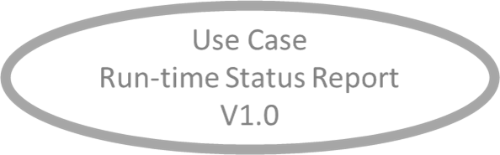




System Use Case “Charge the Car” System Boundary, Interfaces, and Users
→ Method Task: Define the system boundary!
Stakeholder
Illustrate Use Case – Activities!
Charging Station System Operator

Slide 15
Assumptions
None defined yet!

Slide 16
References
[REF_SHC] … SmartHome_ConceptSpecificationSimplified_v2022.1.docx
[REF_FORDCS] … FORD – Charging Station
https://www.evsolutions.com/Upload/Product/635652466512570000.pdf

Slide 17
BACKYARD
BACKYARD

